Slide 1

Client server architecture used by Dropbox and its security & Scalability
Date: <2021-05-13>
Group ID : <xxx-xxx-xxx>
Student ID | Name with initials
IT19051376 | Anjana W.W.M
IT19038292 | Wickramasinghe A.Y.S.W
IT19029900 | Shaman M.A.M
IT19031026 | Kumbukage D.T.
System : Dropbox
Architecture : Client Server Architecture
Key Qualities: Security & Scalability

Slide 2
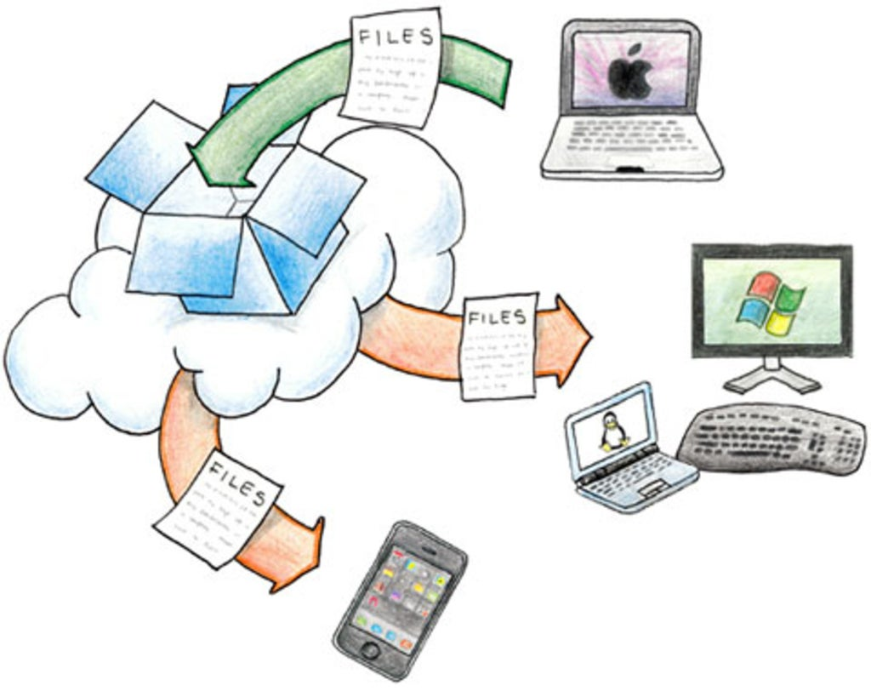
Introduction of Dropbox
IT19051376
Dropbox is the Web-based file hosting service operated by Dropbox.Inc.
A free mobile and web-app tool.
Enable user to store and share file and file across the Internet.
Transfers just the parts of a file that change
Works even when offline.
Works with Windows, Mac, Linux, iPad, iPhone, Android and BlackBerry.

Slide 3

What You can do with Dropbox?
IT19051376
Edit your documents from anywhere
Share documents from anywhere
Back up important files
Collaborate with others

Slide 4
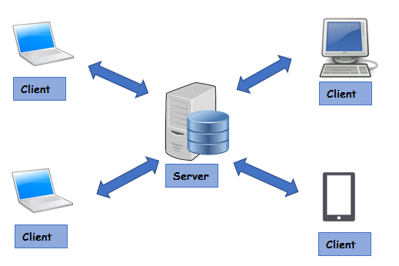
Architectures Use In Dropbox
IT19051376
Basically use client-server Architecture
Magic Pocket Architecture
What is the Client-Server Architecture ?

Slide 5
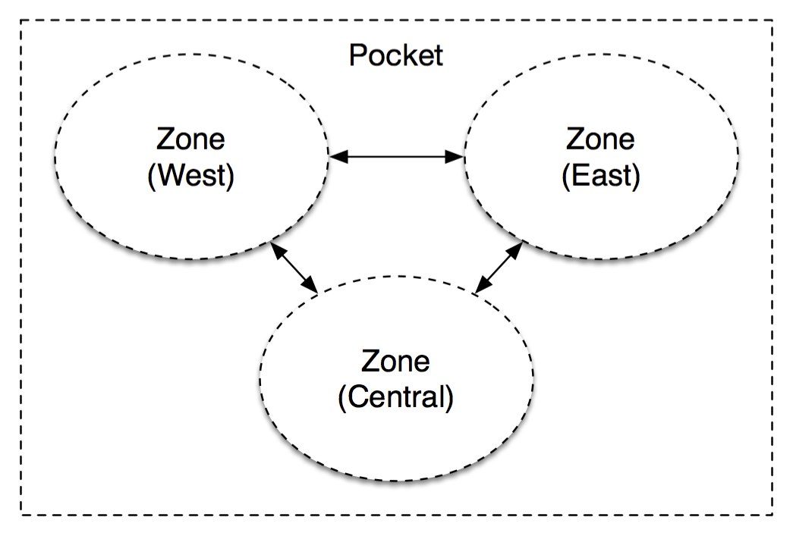
Magic Pocket Architecture
IT19051376
Magic Pocket is a multi-zone architecture
Server clusters in western, central and eastern United States.
Block is stored independently in at least two separate zones

Slide 6
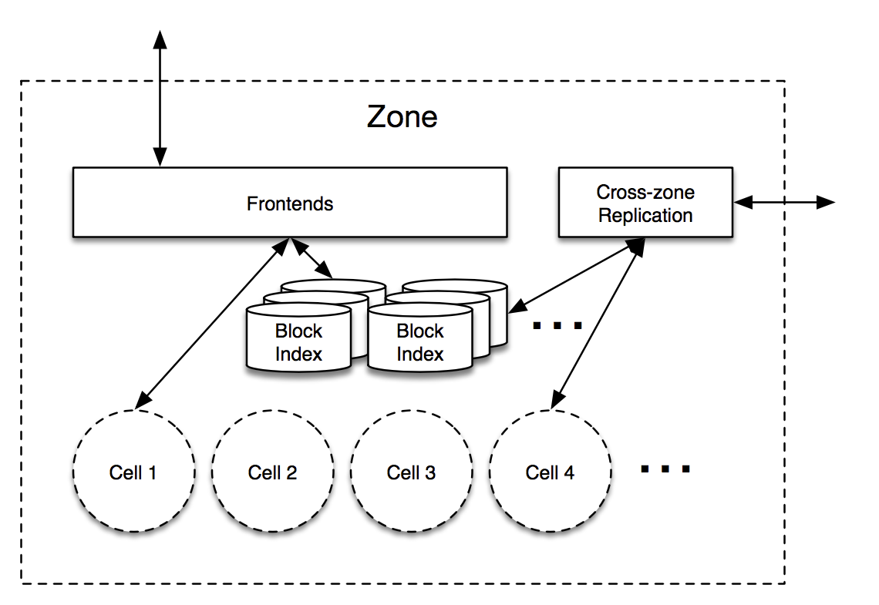
What Happens Inside a Zone…?
IT19051376

Slide 7

Magic Pocket
scalability
IT19029900
Magic Pocket." that name implies that the main purpose of this design is scalability.

Slide 8
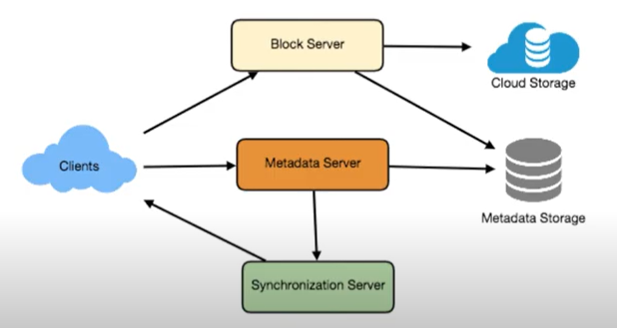
how does dropbox data scale?
IT19029900
dropbox server is divided in to 3 parts
block server - saves client’s uploaded data (File, image...etc.)
metadata server - saves client uploaded names of files and images.
Synchronized server – when client update their data
Why this server logicaly separated?
To make clients work easier and faster
When multiple clients accessed the server

Slide 9
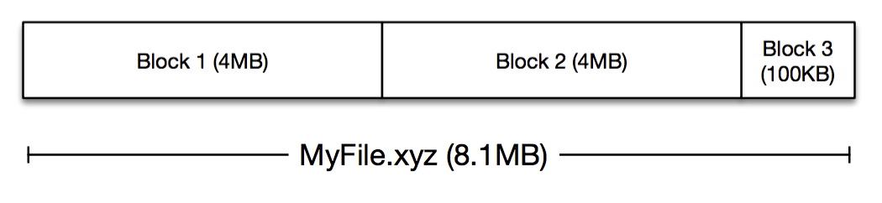
how does dropbox data scale?
IT19029900
Data Model
MP stores blocks, which are opaque chunks of files, up to 4MB in size
Each blocks are compressed and encrypted in SHA-256 hash encryption method

Slide 10
Why we should use client server architecture for improve dropbox’s scalability ?
IT19029900
client server architecture and dropbox main functionality has same purpose
Maintains and improves(update) system scalability
Hides server side complexity
Improves the user scale
multiple clients can access
Improves the data scale.
By providing huge space
Hash coding technology

Slide 11
Why we should use client server architecture for improve dropbox’s scalability ?
IT19029900
we can provide continuous service to the client using server zone

Slide 12
Security
IT19031026
How secure the Dropbox is?
Due to the popularity of the Dropbox, It has a history of hacking incidents. This was probably targeted because it had something of value to target.
Dropbox has had few security problems, including a hack in 2012. But until now, no such incidents has been reported.

Slide 13
IT19031026
How Dropbox protect user files?
Beyond traditional encryption
File recovery and version history
Rigorous security testing
Third-party access

Slide 14
IT19031026
How Dropbox protects user Account?
Choose a unique, strong password
Enable two-step verification
Watch out for phishing and malware
Enable Email Notifications
Unlink Extraneous Devices and Apps

Slide 15
IT19031026
Dropbox has increased its security level
Secure Sockets Layer (SSL)
Transport Layer Security (TLS)
Advanced Encryption Standard (AES)
Dropbox security vs OneDrive Security

Slide 16
4.Compare with competitor systems
IT19038292
* Cloud storage Companies,
Drop Box
Google Drive
OneDrive
I Cloud
i) Architecture
drop box and all other competitor systems basically used Client-server Architecture
System design of drop box vs google drive

Slide 17
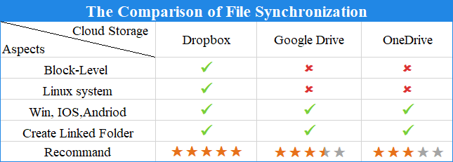
ii) Performance
IT19038292
1) synchronization
Dropbox:
1)smart sync
2)selective sync
2) Upload and download
Upload and download speed of drives depend on size of the file

Slide 18
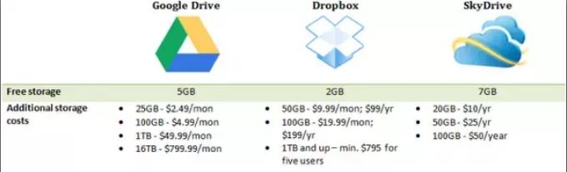
3) Pricing & Storage
IT19038292
Free plans & Paid plans
One Drive and Google drive most Advantageous than drop box.
4)File Sharing
When drop box create a shareable link user can add a password
When drop box create a shareable link user can set an expiration date

Slide 19
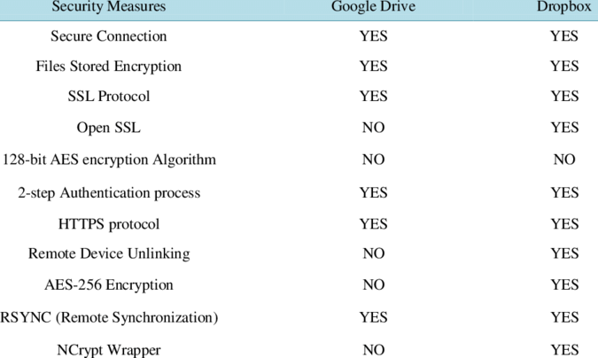
IT19038292
iii) Security
Dropbox technology:
SSL & TLS protection
256-bit encryption (AES)
Google drive technology:
per-file protection
128-bit encryption

Slide 20
IT19038292
Conclusion,
Can use different platforms (specially Linux)
File sharing systems and encryption of drop box better than others competitors
Dropbox present more flexible and quality service to user than other competitors

Slide 21
Reference
X. Zenuni, J. Ajdari, F. Ismaili, and B. Raufi, “Cloud storage providers: a comparison review and evaluation,” Proc. 15th Int. Conf. Comput. Syst. Technol. - CompSysTech ’14, pp. 272–277, 2014.
[15] “Office 365— Our latest innovations in security and compliance.” [Online]. Available: https://www.microsoft.com/en-us/microsoft-365/blog/2014/10/28/office-365- latest-innovations-security-compliance/.
H “Microsoft OneDrive,google drive, drop box Plans. “[Online]. Available: https://www.cloudwards.net/dropbox-vs-google-drive-vs-onedrive
Shamsah Alotaibi , Hadeel Alomair , Mariam Elhussein, https://www.researchgate.net/publication/333158217 Comparing Performance of Commercial Cloud Storage Systems The Case of Dropbox and One Drive
April , 2019

